Slide 1
CS 211 Computer Architecture Lecture 9: ISA - Introduction
Ravi Mittal
ravi.mittal@iitgoa.ac.in
Indian Institute of Technology, Goa

Slide 2
In this class, we will study
Instruction Set Architecture (ISA) - Basics
ISA vs Microarchitecture
ISA – Specification
Microarchitecture
Trivia

Slide 3
Acknowledgements
The contents of the presentation has been taken from many sources. Thanks are due to all original contributors – who made my work simple – by sharing their class/book presentations.
Prof Onur Mutulu, ETH Zurich, Lecture 11 Microarchitecture, Digital Design and Architecture Course
Pratt and Patel, Book, Introduction to Computing Systems: From Bits & Gates to C & Beyond (Computer Engineering)

Slide 4
Instruction Set Architecture (ISA) - Basics

Slide 5
We will learn that is in-between..
“C” as a model of computation
Systems Prog.
Programmer’s view of how
a computer system works
How does an assembly program end up executing as digital logic?
What happens in-between?
How is a computer designed using logic gates and wires to satisfy specific goals?
Architect/microarchitect’s view:
How to design a computer that
meets system design goals.
Choices critically affect both
the SW programmer and
the HW designer
HW designer’s view of how
a computer system works
Digital Design
Digital logic as a
model of computation
From Prof Onur Mutlu’s presentation
Notes:
How is the HW/SW interface designed

Slide 6
Instruction
An instruction is the fundamental unit of work
An instruction is encoded as a sequence of bits. (Just like data!)
Often, but not always, instructions have a fixed length, such as 16, 32, or 64 bits
Control unit interprets instruction: generates sequence of control signals to carry out operation
Operation is either executed completely, or not at all (atomic)
From Book by Patt and Patel

Slide 7
Instruction Set
Instruction Set: A set of instructions for a computer
Different computers have different instruction sets
However, many aspects are common
Example: x86 Instruction set, ARM instruction set, RISC-V Instruction set, MIPS instruction set, SPARC, PowerPC
Early computers had a very simple instruction sets
Led to simplified implementation
The ISA is the interface between what the software commands and what the hardware carries out

Slide 8
Levels of Transformation
Algorithm
Step-by-step procedure that is guaranteed to terminate where each step is precisely stated and can be carried out by a computer
Finiteness
Definiteness
Effective computability
Many algorithms for the same
problem
Problem
Algorithm
Program/Language
Runtime System
(VM, OS, MM)
ISA
(Instruction Set Architecture)
Interface/contract between SW and HW.
What the programmer assumes hardware will satisfy.
ISA (Architecture)
Microarchitecture
Logic
Devices
Electrons
Microarchitecture
An implementation of the ISA
Digital logic circuits
Building blocks of micro-arch (e.g., gates)
From Prof Onur Mutlu’s presentation
Notes:
ISA is the interface between hardware and software… It is a contract that the hardware promises to satisfy.
Algorithm: step by step procedure where each step is effectively computable (by a computer), is definite (precisely defined) – “do until fast” is not definite, and terminates

Slide 9
ISA vs Microarchitecture

Slide 10
ISA vs. Microarchitecture
ISA: Agreed upon interface between software and hardware
Specifies how the programmer sees instructions to be executed
What the software writer needs to know to write and debug system/user programs
Microarchitecture: Specific implementation of an ISA
How the underlying implementation actually executes instructions
Microarchitecture can execute instructions in any order as long as it obeys the semantics specified by the ISA when making the instruction results visible to software
Programmer should see the order specified by the ISA
Microprocessor
ISA + Microarchitecture + circuits
Problem
Algorithm
Program
ISA
Microarchitecture
Circuits
Electrons
From Prof Onur Mutlu’s presentation

Slide 11
ISA vs. Microarchitecture
What is part of ISA vs. Microarchitecture?
Gas pedal of a car: interface for “acceleration”
Internals of the engine: implement “acceleration”
An average driver doesn’t care what is under the hood
Implementation (Microarchitecture) can be various as long as it satisfies the specification (ISA)
Adder implementation
Bit serial, ripple carry, carry lookahead adders are all part of microarchitecture
x86 ISA has many implementations: 286, 386, 486, Pentium, Pentium Pro, Pentium 4, Core, …
Microarchitecture usually changes faster than ISA
Few ISAs (x86, ARM, SPARC, MIPS, Alpha) but many microarchitecture
Why?
From Prof Onur Mutlu’s presentation

Slide 12
The Von-Neumann Model and ISA
All major instruction set architectures today use this model
x86, ARM, RISC, MIPS, SPARC, Alpha, POWER
Underneath (at the microarchitecture level), the execution model of almost all implementations (or, microarchitectures) is very different
Pipelined instruction execution: Intel 80486 microarchitecture
Multiple instructions at a time: Intel Pentium microarchitecture
Out-of-order execution: Intel Pentium Pro microarchitecture
Separate instruction and data caches
What happens underneath that is not consistent with the von Neumann model is not exposed to software

Slide 13
Instruction Set Architecture (ISA) –Specification

Slide 14
ISA Specifies..
The memory organization
Address space (LC-3: 2¹⁶, RISC-V: 2³² )
Addressability (LC-3: 16 bits, RISC-V: 32 bits)
Word- or Byte-addressable (LC-3 is word addressable, RISC-V is byte addressable
Big endian vs. little endian?
Support for virtual memory
The register set
LC-3: R0 to R7
32 registers in RISC-V
The instruction set
Opcodes
Data types
Addressing modes
From Prof Onur Mutlu’s presentation

Slide 15
Opcodes in LC-3

Slide 16
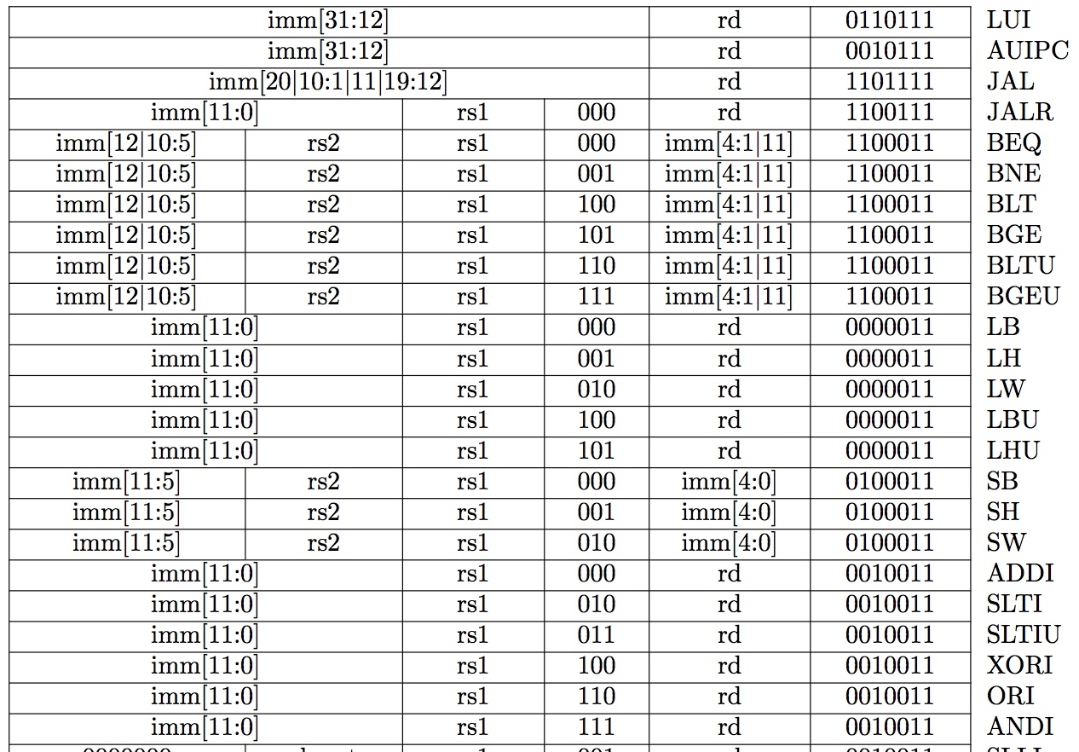
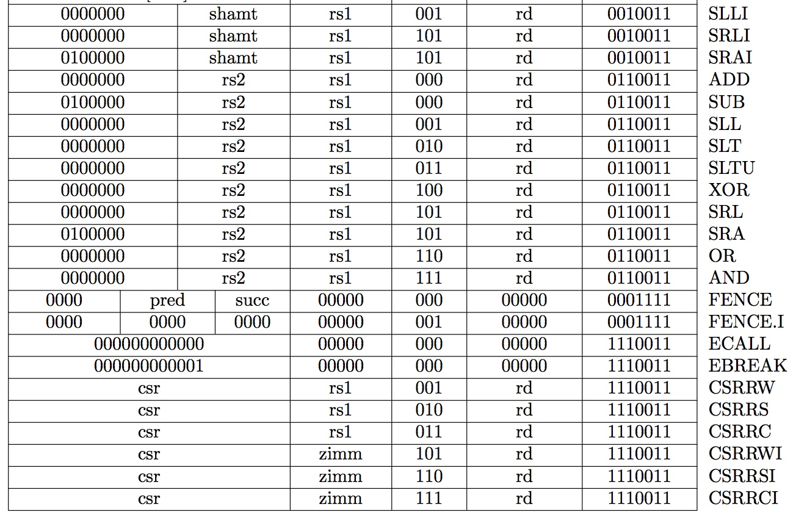
Opcodes in RISC-V (RV32I)

Slide 17
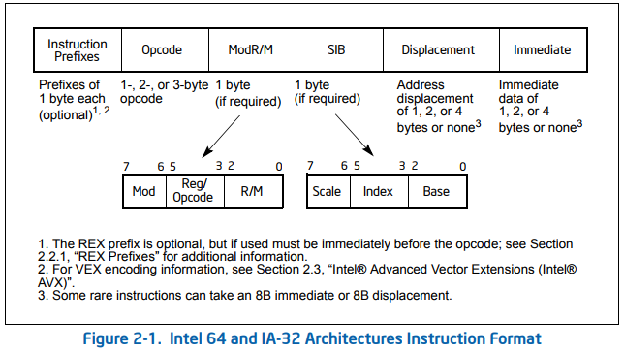
Opcodes in x-86 (64 bits)
Opcode size: 1, 2, or 3 byte
Instruction format changes - based on Instruction prefix

Slide 18
Data Types
Definition: Representation of information for which there are instructions that operate on the representation
Integer, floating point, two’s complement integer, character, binary, decimal, BCD
Doubly linked list, queue, string, bit vector, stack (Not in RISC)
VAX: INSQUEUE and REMQUEUE instructions on a doubly linked list or queue; FINDFIRST
X86: SCAN opcode operates on character strings; PUSH/POP
Even Hash table is a high level data type defined in an ISA
Advantages and disadvantages of high level data types
Too many high level data types make ISA/Microarch complex

Slide 19
Data Types
An ISA supports one or several data types
LC-3 only supports 2’s complement integers
MIPS supports
2’s complement integers
Unsigned integers
Floating point
Tradeoffs
What data types should be supported and what should not be?

Slide 20
Addressing Modes
An addressing mode is a mechanism for specifying where an operand is located
RISC-V Addressing Modes
Register Only (all operands are in registers)
Immediate or literal (constant)
Base Addressing
PC-Relative
Pseudo Direct (for J and jal)
Other addressing Modes (Not in RISC-V)
Direct
Indirect
Index
Register Indirect

Slide 21
Number of operands
Number of operands
0, 1, 2, 3 address machines
0-address: stack machine (push A, pop A, op)
1-address: accumulator machine (ld A, st A, op A)
2-address: 2-operand machine (one is both source and dest)
3-address: 3-operand machine (source and dest are separate)
Tradeoffs
Larger operate instructions – code size
Commonly executed instructions
Number of operands may vary in a processor
Intel x86 instruction can have 0 to 3 operands

Slide 22
Microarchitecture

Slide 23
Microarchitecture
Implementation of the ISA design constraints and goals
Anything done in hardware without exposure to software
Pipelining
In-order versus out-of-order instruction execution
Memory access scheduling policy
Speculative execution
Superscalar processing
Clock gating
Caching: Levels, size, associativity, replacement policy
Prefetching
Voltage/frequency scaling?
Is this feature exposed to programmers? If this is done automatically, then it is a part of Microarchitecture
From Prof Onur Mutlu’s presentation
Notes:
Clock gating is a popular technique used in many synchronous circuits for reducing dynamic power dissipation, by removing the clock signal when the circuit is not in use. Clock gating saves power by pruning the clock tree, at the cost of adding more logic to a circuit.

Slide 24
Quiz: Property of ISA or Microarchitecture?
ADD instruction’s opcode
ISA
Number of general purpose registers
ISA
Number of ports to the register file
Microarchitecture
Number of cycles to execute the MUL instruction
Microarchitecture
Whether or not the machine employs pipelined instruction execution
Microarchitecture
Remember
Microarchitecture: Implementation of the ISA under specific design constraints and goals
From Prof Onur Mutlu’s presentation

Slide 25
Factors to consider when designing ISA
Cost
Performance
Maximum power consumption
Energy consumption (battery life)
Availability
Reliability and Correctness
Time to Market
Application space – drive design considerations
General Purpose Computer
Special Purpose computer
Problem
Algorithm
Program
ISA
Microarchitecture
Circuits
Electrons
From Prof Onur Mutlu’s presentation

Slide 26
Levels of Transformation – A user centric view
Problem
Algorithm
Program/Language
User
Runtime System
(VM, OS, MM)
ISA
Microarchitecture
Logic
Circuits
Electrons
The entire stack should be optimized for user
From Prof Onur Mutlu’s presentation
Notes:
ISA is the interface between hardware and software… It is a contract that the hardware promises to satisfy.

Slide 27
Demands of Applications
Application have varied set of characteristics
Scientific applications
Transaction based applications such as ATM transfers
Data processing applications
Network Applications
Graphics based applications
Embedded Applications
Media applications
This leads to different set of demands and tradeoffs
ISA level tradeoffs
Micro-architecture level tradeoffs
System and Task level tradeoffs (how to divide labor between hardware and software

Slide 28
Different ISAs Over Decades
x86
PDP-x: Programmed Data Processor (PDP-11)
VAX
IBM 360
CDC 6600
SIMD ISAs: CRAY-1, Connection Machine
VLIW ISAs: Multiflow, Cydrome, IA-64 (EPIC)
PowerPC, POWER
RISC ISAs: Alpha, MIPS, SPARC, ARM, RISC - V
What are the fundamental differences?
How instructions are specified and what they do?
How complex are the instructions?

Slide 29
Trivia

Slide 30
Optical Fiber
In today’s class we are using Zoom Session
Bandwidth requirement: 1 Mbps – 2 Mbps (approximately)
How many Zoom Session a single Fiber can carry ?
100 sessions
1000 sessions
10000 sessions
1 Million Sessions
10 Million Sessions
100 Million Sessions

Slide 31
Optical Fiber
In today’s class we are using Zoom Session
Bandwidth requirement: 1 Mbps – 2 Mbps (approximately)
How many Zoom Session a single Fiber can carry ?
100 sessions
1000 sessions
10000 sessions
1 Million Sessions
10 Million Sessions
100 Million Sessions
https://spectrum.ieee.org/tech-talk/telecom/internet/single-optical-fibers-100-million-zoom

Slide 32
Nielsen's Law of Internet Bandwidth
Users' bandwidth grows by 50% per year
10% less than Moore's Law for computer speed
The new law fits data from 1983 to 2019

Slide 33
Backup

Slide 34
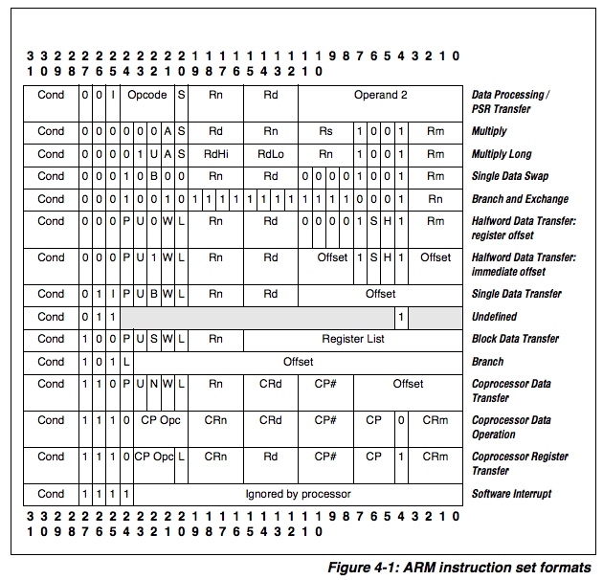
ARM

Slide 35
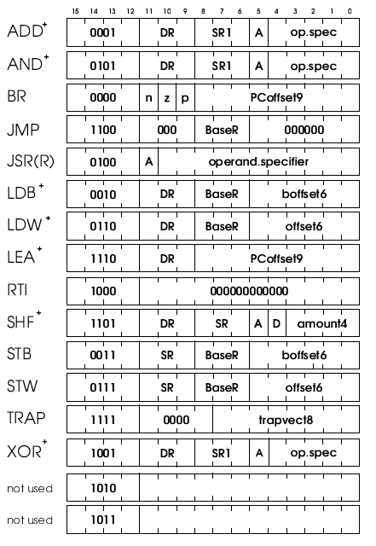
LC-3b ISA
LC-3b ISA
http://users.ece.utexas.edu/~patt/17s.460N/handouts/new_byte.pdf
Concept of “bit steering”
A bit in the instruction determines the interpretation of other bits

Slide 36
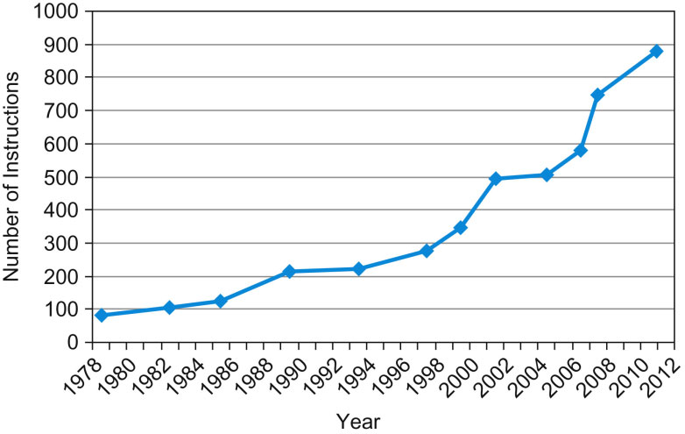
X86-64 ISA
Just too many instructions and details to fit into this page..
Too complex

Slide 37
X86-64 ISA
x86-64 ISA manual has over 3,800 pages
This makes compiler very complex
And many other issues..
Complex Instruction Set Architecture
Yet. Intel is very successful

Slide 38
The instruction format determines the behavior and complexity of the instruction fetch (IF) and decode (ID) pipeline stages
Fixed-size makes fetching instructions easy: just get the next n bytes.
Fixed-size enables a decoding optimization known as direct encoding, in which the bits of the opcode’s value are mapped directly to various CPU control flags. E.g., one bit in the opcode might specify whether the Ex pipeline stage is enabled. Four bits might specify an index into the register file for the source register. This implies that the Decode pipeline stage is a no-op: once we have loaded the instruction, it is already decoded.

Slide 39
Instruction fetch and decode are inextricably mixed with variable-width instruction formats. We cannot know how long the instruction is until we have decoded at least part of it. Ideally, the low byte of the instruction contains enough information to know the full instruction size, so that the process is: Fetch 1 byte, Decode, Fetch remaining bytes, Decode. Often, however, this is not the case, and the IF and ID proceed in a loop-like fashion: fetch the beginning of the instruction, decode it to determine how much more to fetch, then fetch more, decode, and so forth, until the entire instruction has been fetched and decoded.
Decoding variable-size instructions, even if the entire instruction is available (it isn’t!) is more complex. Direct encoding is almost impossible. The relevant parts of the instruction may be in different places for different instructions. As we’ll see below, MIPS has only three different instruction formats, and the operation is always in the same place in all three. x86, in contrast, has
Extending a variable-size instruction format with new instructions is relatively easy.

Slide 40
Types of Instructions
Operate instructions
Process data: arithmetic and logical operations
Data movement instructions
Move data between memory, registers, I/O devices
Control flow instructions
Change the sequence of instructions that are executed

Slide 41
Addressing Modes
Addressing modes specify how to obtain the operands
Absolute or immediate: LW rt, 10000
use immediate value as address
Register Indirect: LW rt, (r_{base})
use GPR[r_{base}] as address
Displaced or base+Offset: LW rt, offset(r_{base})
use offset+GPR[r_{base}] as address
Indexed: LW rt, (r_{base}, r_{index})
use GPR[r_{base}]+GPR[r_{index}] as address
Memory Indirect LW rt ((r_{base}))
use value at M[ GPR[ r_{base} ] ] as address
Auto inc/decrement LW Rt, (r_{base})
use GRP[r_{base}] as address, but inc. or dec. GPR[r_{base}] each time
Notes:
Indexed mode for gather scatter.

Slide 42
Evolution of Register Architecture
Accumulator
a legacy from the “adding” machine days
Accumulator + address registers
need register indirection
initially address registers were special-purpose, i.e., can only be loaded with an address for indirection
eventually arithmetic on addresses became supported
General purpose registers (GPR)
all registers good for all purposes
grew from a few registers to 32 (common for RISC) to 128 in Intel IA-64

Slide 43
Elements of ISA –Register (Repeat)
Registers
How many?
Size of each register
Why - having registers a good idea?
Because programs exhibit a characteristic called data locality
A recently produced/accessed value is likely to be used more than once (temporal locality)
Storing that value in a register eliminates the need to go to memory each time that value is needed
Registers are built directly in hardware – so they are very fast – faster than 1 ns i.e. 5-10 times faster than cache memory
In Load-store (register –register) architecture, data never goes to ALU from memory. Data is first brought to registers.

